Slide 1
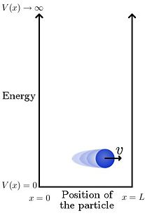

Solving the Particle in a Box Problem Computationally
https://en.citizendium.org/wiki/Particle_in_a_box
Jeffery Hu, Victor Weng, Nick Waterhouse-Currie, Edwin Kim
Research Question:
Using Schrodinger’s equation, how can we find and plot the wavefunction and probability distribution of where we can find a particle in a box?
https://www.crwflags.com/fotw/flags/ca-sk-mj.html

Slide 2
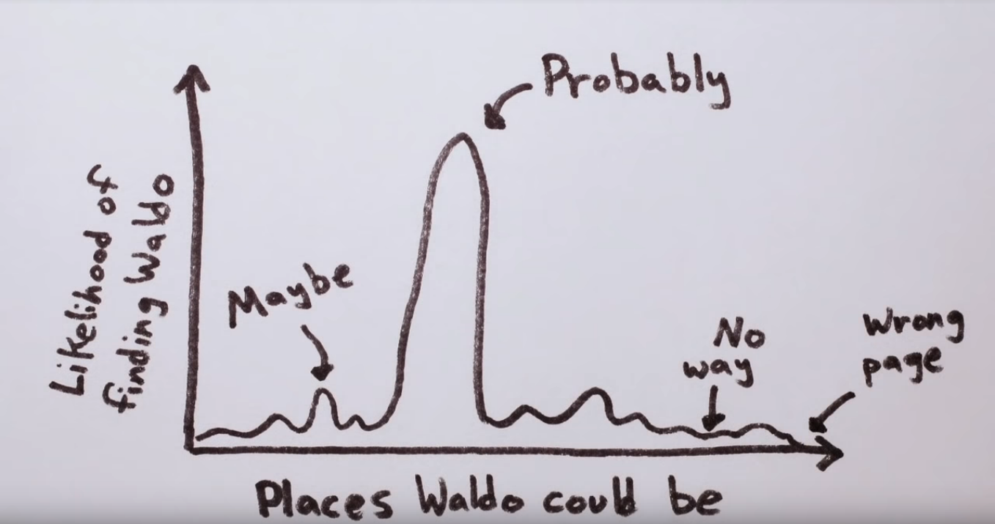

1. Introduction to Particle in a Box
Particles can be represented as probability waves as to where it will occur
Using Schrödinger’s equation, we found the probability of where a particle would be found at different positions of x
Planck's Constant
Schrödinger’s equation:
Energy
Function which represents the distribution of potential energy in which the particle is found.
Mass
If u see this ur a god

Slide 3
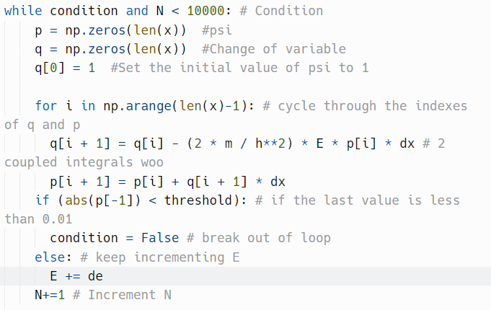
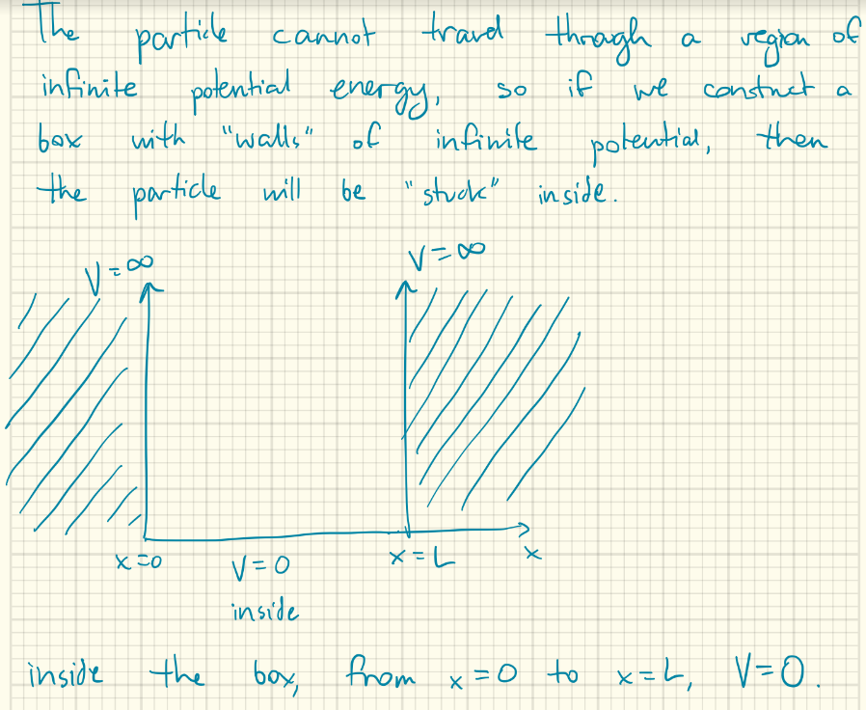

2. Code
Used change of variable method to split up the second derivative
Calculated it using loops and if statements (for end conditions)

Slide 4
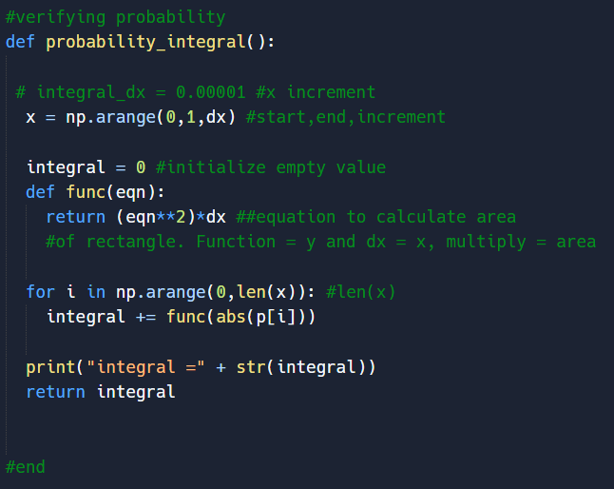
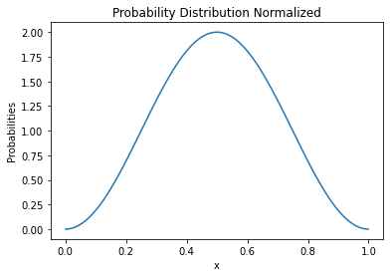
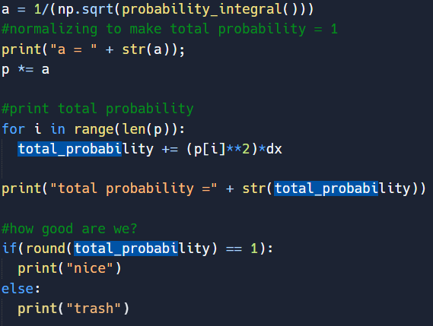
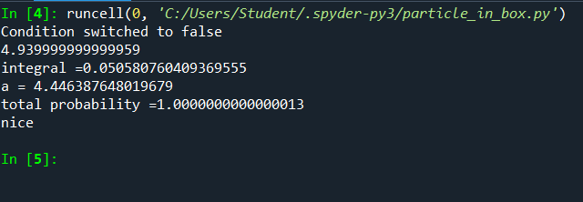
3. Result
*Confirmed as the total probability is equal to 1
Notes:
Show a plot of your results and discuss what these results mean, physically
Alternatively, instead of showing a slide, you can also run your code and show an animation on the projector
Saving non-animated plots in Python:
plt.plot(x,y) plt.savefig(‘figure.png’) plt.show()

Slide 5
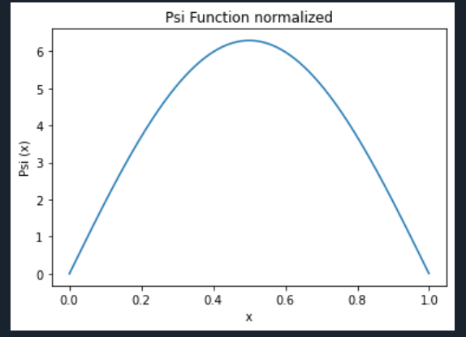
4. Result

